Slide 1
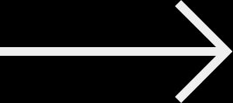
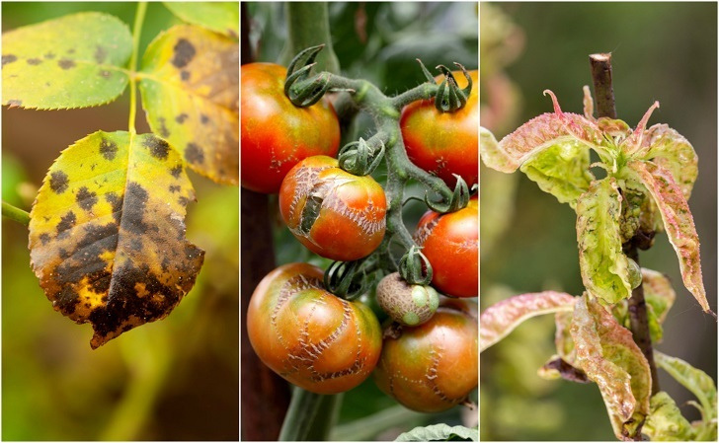

LEAF SENSE
TEAM_3
PLANT_DISEASE_CLASSIFICATION_SYSTEM
UNDER GUIDANCE OF SIBI MANICKAM SIR

Slide 2
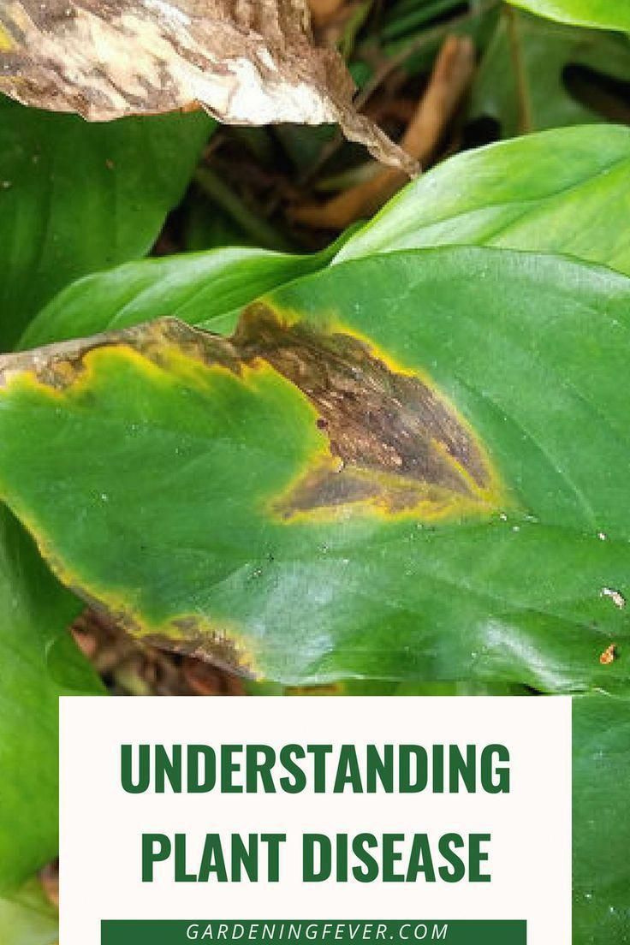

Discussion Points
01
TEAM
02
INTRODUCTION
03
DATASET
04
MODEL
05
DATA COLLECTION
06
PREPROCESSING
07
MODELLING
08
HOW, PROJECT WILL HELP PEOPLE
09
FEASIBILITY & SCALABILITY
10
DEMONSTRATION & LEARNINGS

Slide 3



TEAM_3
ARYAN JAISWAL
AASTHA PATIL
NALLAMILLI NAGA SREYA
VEMULA ANITHA

Slide 4
ABOUT OUR WEBSITE
.... No more paperwork roadblocks....

Slide 5
WHY US?

Slide 6

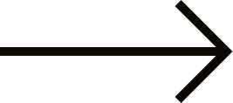
WHAT WE OFFER
We offer a robust, scalable, and user-friendly solution to effectively tackle plant diseases, empowering farmers and enhancing agricultural productivity. Our cutting-edge technology leverages advanced AI and machine learning to provide accurate disease detection and timely intervention, significantly reducing crop losses. By promoting sustainable farming practices, our solution minimizes the use of chemicals, benefiting both the environment and crop health. Our comprehensive approach includes an intuitive mobile application, real-time monitoring capabilities, and continuous expert support. This ensures that users have the essential tools, knowledge, and resources they need to protect their crops, maximize yields, and achieve long-term agricultural success.

Slide 7
MODULES USED
TensorFlow/Keras: Frameworks used for building and training the CNN model.
OpenCV: Library used for image processing tasks.
NumPy & Pandas: Libraries for numerical computations and data manipulation.
Matplotlib/Seaborn: Libraries for data visualization.

Slide 8
WEB FLOW
(UI/UX)

Slide 9

Our plant disease classification project leverages Flask, HTML, and CSS to create an intuitive and responsive web application for users to diagnose and manage plant diseases. Here's an overview of the web flow:
1. Home Page:
Introduction: The home page provides an overview of the project's purpose and benefits, highlighting the importance of early disease detection.
Navigation: Users can navigate to different sections such as disease information, upload page, and contact support.
2. Disease Information Page:
Detailed Descriptions: This page offers detailed information about various plant diseases, including symptoms, causes, and treatment options.
Search Functionality: Users can search for specific diseases or browse through categories based on different crops.
3. Upload Page:
Image Upload: Users can upload images of plant leaves showing symptoms. The upload page features a simple form with an image input field.
Instructions: Clear instructions are provided on how to take and upload clear and accurate images for better diagnosis.

Slide 10
4. Image Processing and Diagnosis:
Backend Processing: Once an image is uploaded, it is sent to the Flask backend, where the trained CNN model processes it to classify the disease.
Real-Time Feedback: The system provides real-time feedback, displaying the diagnosis result along with confidence scores.
5. Results Page
Diagnosis Results: Users receive detailed results including the detected disease, confidence level, and recommended treatments.
Additional Resources: Links to additional resources and articles related to the diagnosed disease are provided for further reading.
6. User Dashboard
History and Records: A personalized dashboard where users can view their previous uploads and diagnosis results.
Profile Management: Users can manage their profiles, update personal information, and set preferences.
7. Support and Contact Page
Contact Form: A form for users to reach out for support, ask questions, or provide feedback.
FAQ Section: Frequently asked questions and answers to help users navigate and use the application effectively.

Slide 11
TECHNICAL IMPLEMENTATION
Flask Backend: Handles routing, image processing, and interaction with the trained CNN model.
Routes: Defined routes for handling page requests, image uploads, and result displays.
Model Integration: The CNN model is loaded and used for prediction in the backend.
HTML and CSS Frontend: Ensures a responsive and user-friendly interface.
HTML: Structures the content and layout of the web pages.
CSS: Provides styling to enhance the visual appeal and user experience.

Slide 12
DATASET

Slide 13
ABOUT THE DATASET
The dataset consists of high-quality images of plant leaves, each labeled with the corresponding disease name or as healthy. Images are taken in varied lighting conditions and from different angles to ensure diversity.
The dataset used in our plant disease classification project includes images of various crops affected by multiple diseases. Here are the details:
Crops and Their Diseases
Tomatoes - Yellow Leaf Curl Virus, Target Spot, Spider Mites, Septoria Leaf Spot, Mosaic Virus, Leaf Mold, Late Blight, Early Blight, Bacterial Spot
Roses - Sawfly Sting, Rust
Rice - Leaf Blast, Brown Spot, Hispa
Potatoes - Late Blight, Early Blight
Mangos - Rust Leaf Disease, Anthracnose Fungal
Grapes - Leaf Blight, Esca, Black Rot
Corn - Northern Leaf Blight, Common Rust, Cercospora Leaf Spot
Cassava - Mosaic Disease, Green Mottle, Brown Streak, Bacterial Blight
Bell Pepper - Bacterial Spot

Slide 14
MODEL

Slide 15
CNN ARCHITECTURE
A sequential model was used, consisting of multiple layers:
Convolutional Layers: To extract features from the input images using filters/kernels.
Pooling Layers: To reduce the spatial dimensions of the feature maps, typically using MaxPooling.
Fully Connected Layers: To perform classification based on the extracted features.
Activation Functions: ReLU activation functions used for hidden layers and softmax for the output layer.
Compilation: The model was compiled using an appropriate loss function (e.g., categorical cross-entropy) and optimizer (e.g., Adam).
Training: The model was trained on the training set, and its performance was validated on the validation set. Early stopping and model checkpointing could have been used to prevent overfitting.

Slide 16
DATA COLLECTION

Slide 17
DATA COLLECTION
Collection Method: Data was collected through publicly available datasets or by manually capturing images of plant leaves using a camera.
Data Augmentation: To enhance the dataset, various data augmentation techniques like rotation, flipping, zooming, and shifting could have been applied to artificially increase the number of training samples.

Slide 18
PREPROCESSING

Slide 19
DATA PREPROCESSING
Resizing: Images resized to a uniform size (e.g., 128x128 or 256x256 pixels) to ensure consistency and reduce computational load.
Normalization: Pixel values normalized to a range of 0-1 by dividing by 255.0 to standardize the input.
Splitting: The dataset was split into training, validation, and test sets to evaluate the model's performance properly.
Data Augmentation: Further data augmentation applied during training to improve model robustness and generalization.

Slide 20
MODELLING

Slide 21
LAYERS IN CNN ARCHITECTURE
Input Layer: The input shape corresponds to the dimensions of the resized images (e.g., 128x128x3 for colored images).
Convolutional Layers: These layers are responsible for extracting features from the input images.
Conv2D Layers: Multiple convolutional layers are used, each with several filters (e.g., 32, 64, 128). The filters slide over the image and detect various features such as edges, textures, and patterns.
Activation Function: ReLU (Rectified Linear Unit) is applied after each convolution to introduce non-linearity.
Pooling Layers: These layers reduce the spatial dimensions of the feature maps, which helps in reducing the computational complexity and preventing overfitting.
MaxPooling2D Layers: Applied after convolutional layers to down-sample the feature maps.
Dropout Layers: Dropout is a regularization technique used to prevent overfitting by randomly setting a fraction of the input units to zero during training.
Flatten Layer: This layer converts the 2D feature maps into a 1D feature vector, making it suitable for the dense (fully connected) layers.
Fully Connected (Dense) Layers: These layers perform the final classification based on the extracted features.

Slide 22




HOW OUR, PROJECT WILL HELP PEOPLE

Slide 23
IMPACT ON SOCIETY
Early Detection and Treatment: Farmers can identify diseases early, enabling timely intervention and reducing crop losses.
Cost Savings: Automated disease detection minimizes the need for frequent expert consultations and manual inspections, cutting down operational costs.
Enhanced Support and Training: Agricultural extension workers can provide more accurate advice and use the tool for training farmers and new extension workers.
Informed Decision-Making: Agricultural businesses and cooperatives can make better decisions on crop management and supply chain optimization, ensuring healthy crops reach the market.
Promoting Sustainable Practices: Early detection leads to targeted use of pesticides and fertilizers, promoting sustainable farming practices and reducing environmental impact.

Slide 24
FEASIBILITY

Slide 25
FEASABILITY
Technological Availability: The technology required for this project, including high-resolution cameras, smartphones, and computational resources, is widely available and increasingly affordable.
Data Accessibility: Publicly available datasets like PlantVillage provide a substantial amount of data to train initial models. Additional data can be collected by farmers and researchers using smartphones.
Machine Learning Frameworks: Robust and user-friendly frameworks such as TensorFlow and Keras make it feasible to develop, train, and deploy CNN models efficiently.
Implementation Simplicity: Building a CNN model with sequential architecture is straightforward, making it accessible even for teams with moderate machine learning expertise.
Infrastructure Support: Cloud computing platforms (e.g., AWS, Google Cloud, Azure) offer scalable resources for training and deploying models, making it feasible to handle large datasets and complex computations.

Slide 26
SCALABILITY

Slide 27
SCALABILITY
Model Generalization: The CNN model can be trained to recognize a wide range of diseases across different crops, making it adaptable to various agricultural contexts globally.
Data Augmentation and Collection: New data from different regions and conditions can be continuously collected and used to retrain the model, enhancing its accuracy and robustness over time.
Deployment Platforms: The model can be deployed on multiple platforms, including mobile apps and web applications, making it accessible to a large number of users.
IoT and Automation Integration: The model can be integrated with IoT devices for real-time monitoring and automated disease detection in large-scale agricultural operations.
Cloud-Based Solutions: Utilizing cloud-based solutions for storage, processing, and deployment ensures that the project can scale to meet the needs of large user bases without significant infrastructure investments.

Slide 28
DEMONSTRATION

Slide 29

Lear﻿nings
VERSION CONTROL AND COLLABORATION
DOCUMENTATION AND COMMUNICATION
PROJECT PLANNING
DESIGN AND WIREFRAMING
We learned how to gather requirements from stakeholders (team members, clients, or users). Understanding the project scope, goals, and constraints is crucial for successful planning.
During the design phase, we explored wireframing tools or techniques to create a visual representation of our website’s layout.
Learning about user experience (UX) design principles and creating intuitive interfaces was essential.
Using Git for version control allowed us to collaborate effectively with our team.
We learned about branching, merging, and resolving conflicts.
Experience with DBMS projects is highly sought after in industries such as software development, data analysis, and database administration. It can open doors to exciting career opportunities and advancement.

Slide 30
GITHUB

Slide 31


